Slide 1

MUDI Group Holding
DRC expansion | Capital raise (USD 0.5M – 5M+) | Advisory mandate discussion
Prepared for: Verdant Capital | Confidential
Notes:
[Sources] - https://www.sciencestockphotos.com/free/optics/slides/optical_fibers.html (image license page; image used as title background) [/Sources]

Slide 2
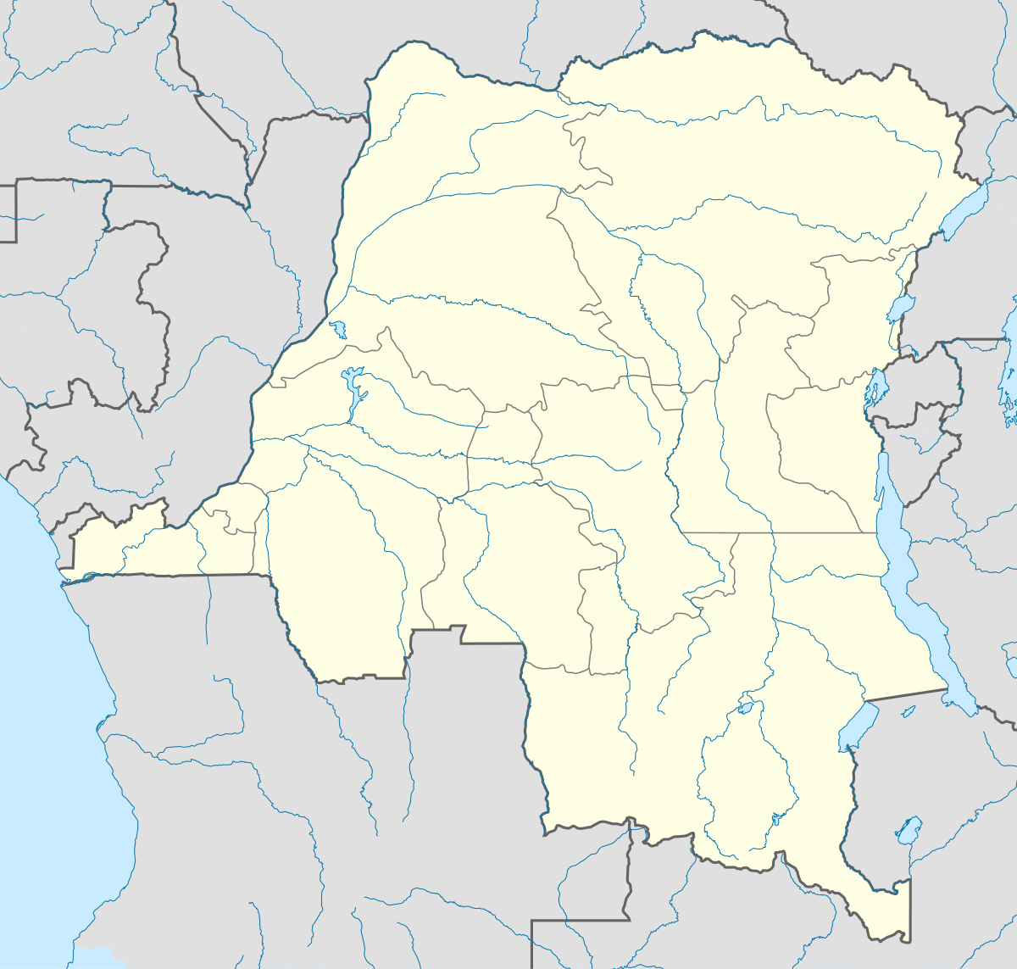
Executive summary
MUDI Group Holding × Verdant Capital
THE ASK
Engage Verdant Capital as sole financial advisor & arranger
Structure a phased capital raise (USD 0.5M–5M+).
Build investor materials (IM + model + data room).
Source and manage outreach to DFIs, PE/growth, and strategic investors.
Close the first tranche aligned to DRC operating launch (warehouse + working capital).
WHY NOW
DRC telecom market expanding rapidly; data-led investment cycle underway.
Unified telecom licensing (20-year horizon) improves infrastructure bankability.
National digital program and large fiber / base station rollouts create immediate equipment demand.
Local warehouse + inventory model reduces delivery times vs importing from hubs.
Initial focus: Kinshasa (launch) → expansion to additional DRC cities
Confidential – discussion materials for Verdant Capital
Notes:
[Sources] - https://www.mordorintelligence.com/industry-reports/democratic-republic-of-the-congo-telecom-mno-market (market sizing and sector context) - https://bankable.africa/en/business-climate/1112-2123-drc-issues-unified-telco-licences-to-operators-in-sector-shake-up (unified licences issued on 5 Dec 2025) - https://developingtelecoms.com/telecom-technology/optical-fixed-networks/16925-socof-and-apcsc-to-deploy-fibre-along-new-roads-in-the-drc.html (SOCOF/APCSC fiber initiative) [/Sources]

Slide 3
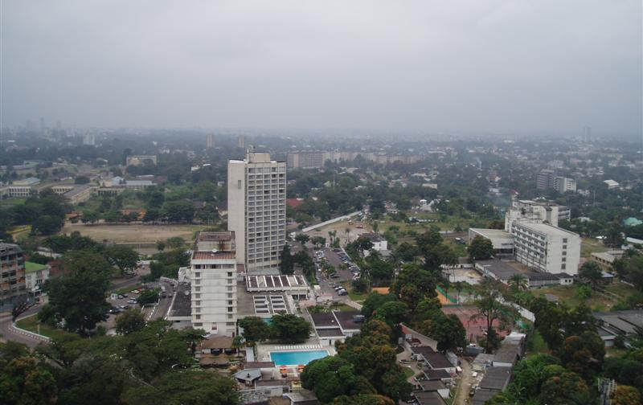
MUDI Group at a glance
Dubai Mainland LLC | Operating in UAE, Ivory Coast, Senegal
Pan-African telecom infrastructure & technology solutions provider
Sourcing advantage via manufacturing partnerships; delivering full-stack equipment plus services through a unified operating model.
GROUP STRUCTURE
MUDI Group Holding
MUDITEL
MUDILOG
MUDICARE
MUDISERVE
Telecom & digital
Logistics
Medical
Services
MUDITEK (planned): AI-enabled branch solutions + hardware (future vision)
Kinshasa (launch market)
Note: MUDITEK is a planned entity (not yet registered)
Notes:
[Sources] - https://commons.wikimedia.org/wiki/File:Kinshasa-Gombe,_from_CCIC.JPG (image) [/Sources]

Slide 4
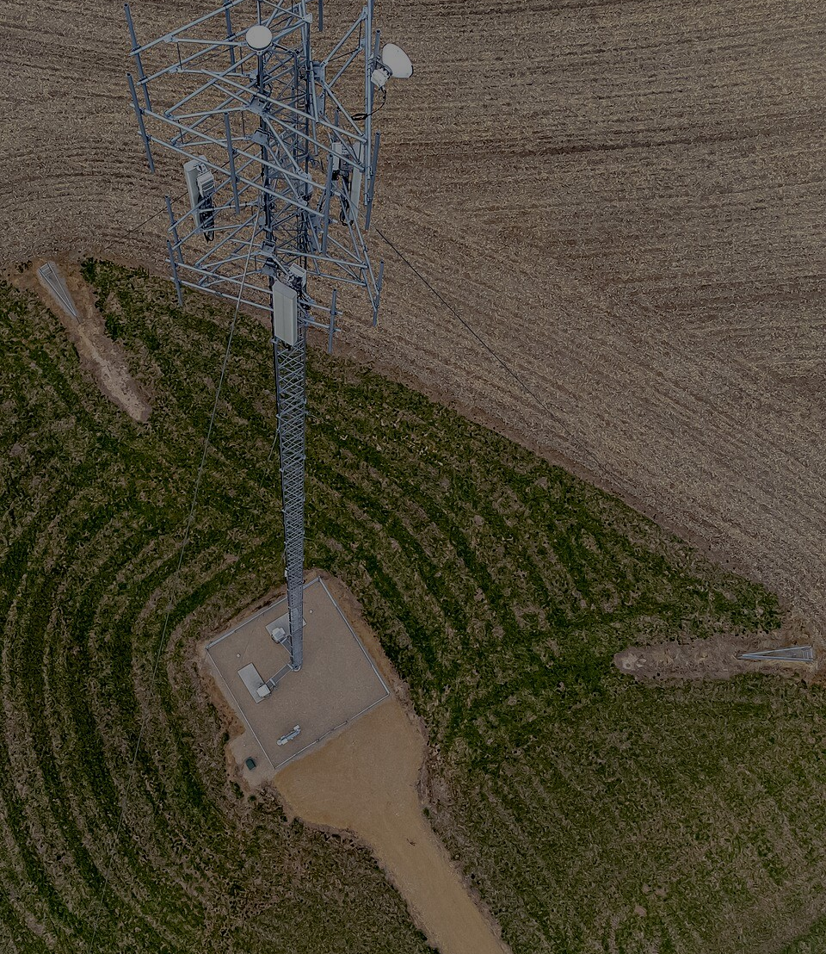
What we deliver
Full-stack telecom infrastructure + technology supply
PRODUCT LINES
One supplier
across the build-out
Fiber optics
Towers & RF
Cables, ODN/ODF, splice closures
Tools & test (OTDR, splicers)
Accessories & civil materials
Towers, shelters, grounding
Antennas, feeders, DAS
RRU/BBU accessories
Reduce complexity: fewer vendors, faster procurement, consistent specs.
Energy systems
Networking & IT
Solar, batteries, hybrid cabinets
Rectifiers, UPS, power cabinets
Generators & accessories
Switches/routers/APs, racks
CCTV & security systems
Branded hardware (laptops/tablets)
HDPE & piping
VSAT / satellite
HDPE ducts, micro-duct
Manholes & civil accessories
Valves & fittings
VSAT antennas, LNB/LNA
Routers & backhaul components
Remote connectivity kits
Equipment supply + services are consolidated under MUDITEL (products) and MUDISERVE (services).
Notes:
[Sources] - https://commons.wikimedia.org/wiki/File:Cell_tower_aerial.jpg (image, CC0) [/Sources]

Slide 5
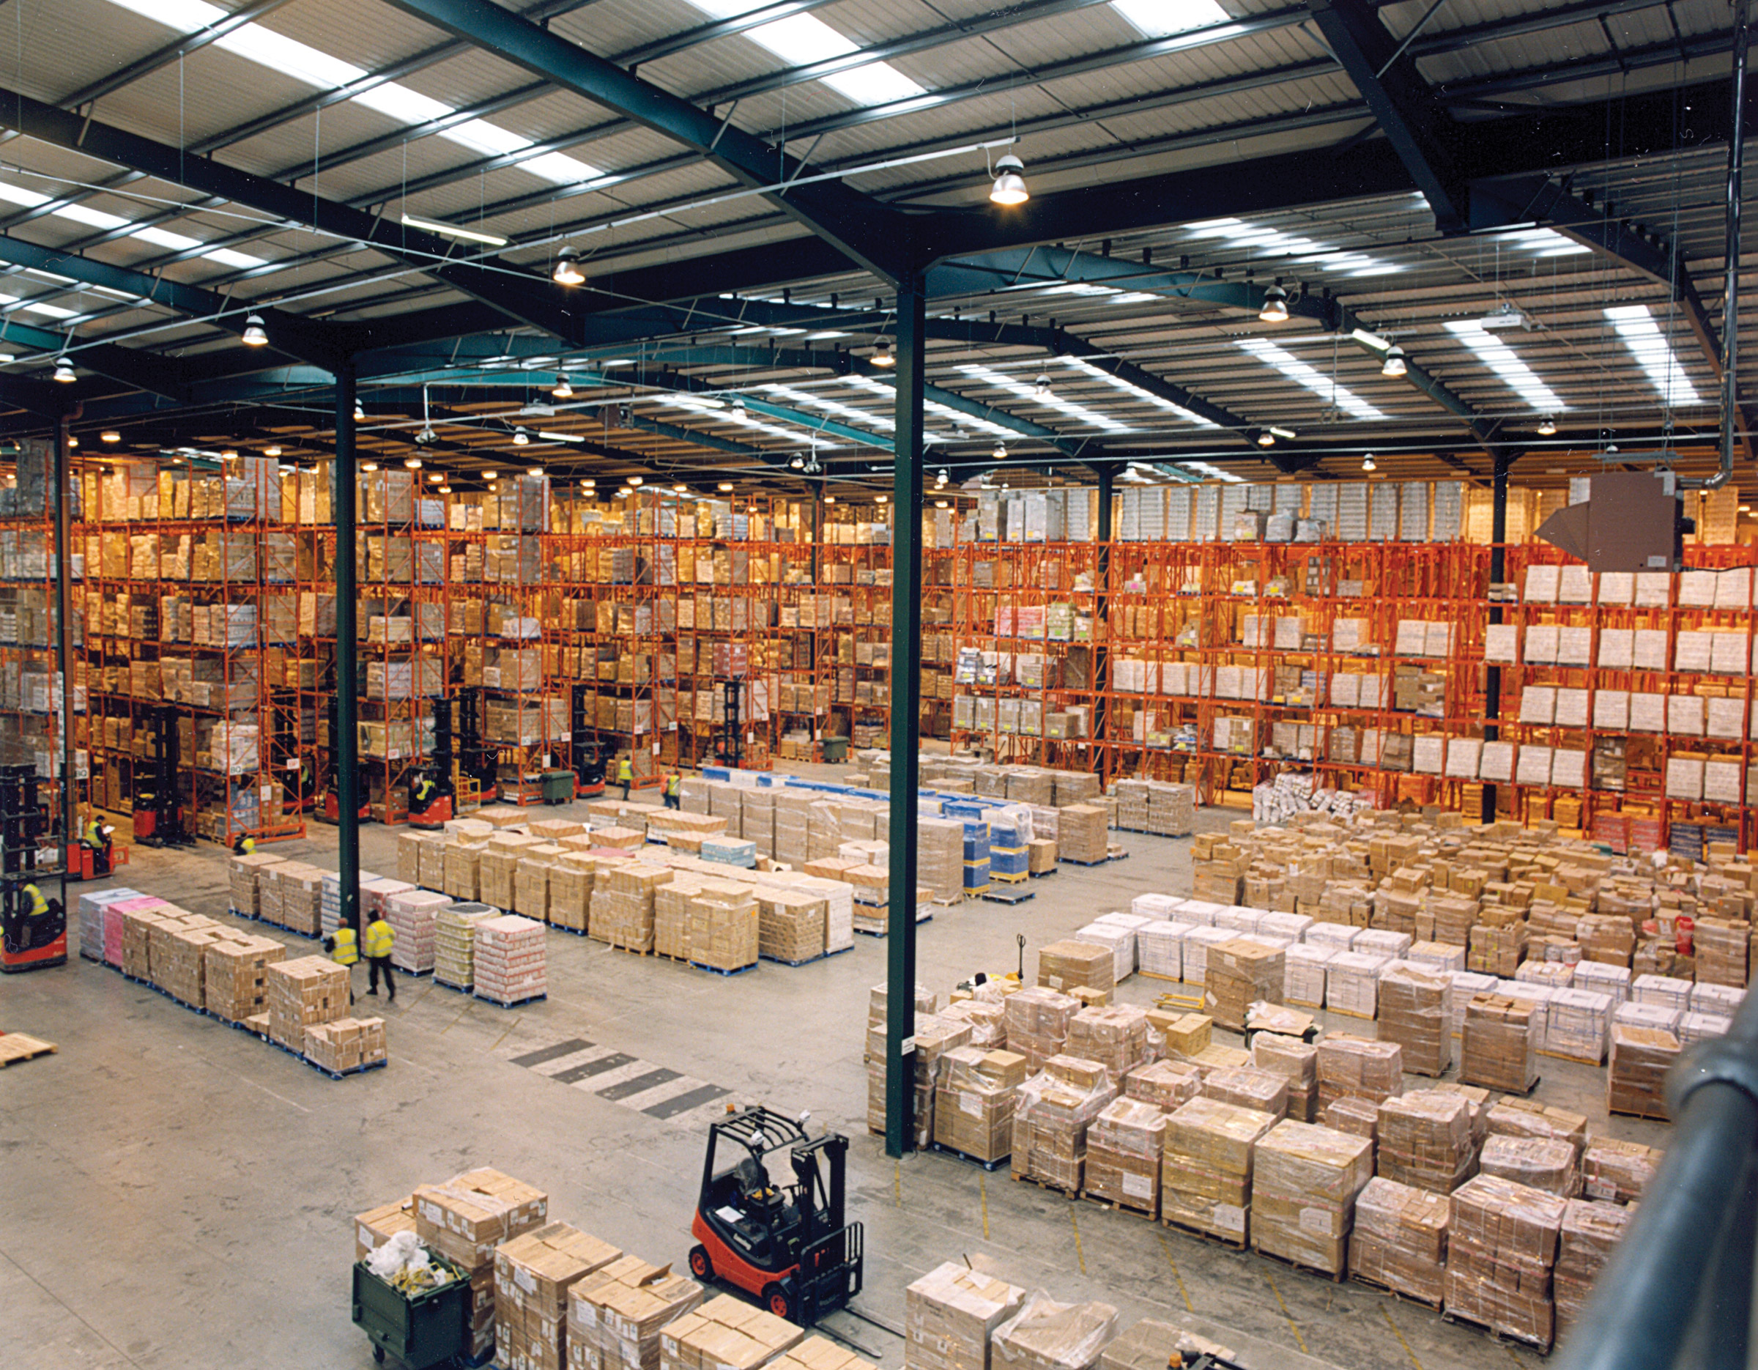
Traction & proof points
Execution capability across multiple markets
DELIVERED
600 Muditel-branded laptops delivered (execution + brand presence).
World Bank-financed school infrastructure project: 46 schools (USD 600K), executing with scale-up pipeline.
Operating footprint: UAE, Ivory Coast, Senegal.
Inventory-led model (illustrative)
WHAT THIS SIGNALS
Ability to source, ship, clear, and deliver on schedule.
Institutional counterparties (development-financed projects).
Repeatable operating model for new country launches.
3
active markets
600
branded laptops delivered
$600K
school project (executing)
46
schools in current project
Note: detailed project bill-of-materials and delivery evidence shared in diligence pack.
Notes:
[Sources] - https://commons.wikimedia.org/wiki/File:Modern_warehouse_with_pallet_rack_storage_system.jpg (image) [/Sources]

Slide 6
DRC market inflection
Demand signals that match our product lines
CATALYSTS
Telecom market growth (illustrative)
Unified telco licences issued to Vodacom, Orange, Airtel & Africell (20-year horizon).
National “Digital Nation 2030” plan (~EUR 8.7B) driving connectivity, services and skills.
SOCOF/APCSC initiative targeting ~7,000 km of fiber along new road corridors.
Orange + Vodacom rural coverage JV (shared active/passive equipment; long-term build-out).
CAGR 11.25%
USD (billions)
6.24B
3.66B
2025
2030
WHAT THIS CREATES
Immediate demand for fiber + civil materials, towers/RF components, and off-grid energy systems (solar/batteries) – enabled by longer regulatory horizon and large public/private programs.
Figures shown are sourced externally; we will align the investment case to Verdant’s preferred sources in the IM.
Notes:
[Sources] - https://www.mordorintelligence.com/industry-reports/democratic-republic-of-the-congo-telecom-mno-market (market sizing) - https://bankable.africa/en/business-climate/1112-2123-drc-issues-unified-telco-licences-to-operators-in-sector-shake-up (unified licences; 5 Dec 2025) - https://www.biometricupdate.com/202601/drc-envisages-a-functional-digital-government-platform-by-march (Digital Nation 2030; 8.7B euros) - https://developingtelecoms.com/telecom-technology/optical-fixed-networks/16925-socof-and-apcsc-to-deploy-fibre-along-new-roads-in-the-drc.html (SOCOF/APCSC fiber initiative) - https://newsroom.orange.com/orange-and-vodacom-create-a-joint-venture-to-expand-network-coverage-in-rural-areas-in-the-drc/ (Orange/Vodacom JV) [/Sources]

Slide 7
DRC value proposition
Why buyers choose MUDI
⚡ Local availability (warehouse + stock) Reduce lead times and downtime vs importing per order; support urgent roll-outs.
💰 Cost competitiveness Manufacturing partnerships and centralized procurement improve landed cost economics.
🧩 Full-stack procurement Fiber + towers + power + networking in one relationship; simpler BoM alignment.
🛠️ Service layer (MUDISERVE) Installation support, spares strategy, warranty handling, and after-sales execution.
Positioning note: MUDITEK is a future vision to add AI-enabled business solutions on top of the core infrastructure platform.

Slide 8
DRC operating model
Warehouse-led distribution + project supply
How we win in-market
Stock fast-moving SKUs locally (fiber accessories, power components, RF consumables).
Quote quickly with landed-cost discipline and clear lead-times.
Bundle equipment + light services for project execution (MUDISERVE).
Use MUDILOG to manage regional freight, customs and last-mile delivery.
Expand from Kinshasa to additional provinces based on contract concentration.
Primary buyer groups
Mobile Network Operators (MNOs)
TowerCos / infrastructure owners
EPC / fiber contractors
Government & development-financed projects
Warehouse photo is illustrative only.
Notes:
[Sources] - https://commons.wikimedia.org/wiki/File:Modern_warehouse_with_pallet_rack_storage_system.jpg (image) [/Sources]

Slide 9
Execution plan
Milestones aligned to the phased raise
Phase 1 (0–6 months) – Launch Kinshasa - Register local presence; compliance and banking setup.
- Lease warehouse + basic racking; implement inventory controls.
- Initial stock for fast-moving SKUs; establish freight lanes.
- Hire core team (country lead, sales, ops/logistics).
Phase 2 (6–18 months) – Scale contracts - Broaden inventory across product categories; add spares strategy.
- Expand account coverage (MNOs, TowerCos, contractors).
- Add installation/maintenance offers through MUDISERVE.
- Option to pilot MUDITEK solutions with select enterprise clients.
Phase 3 (18–36 months) – Multi-city platform - Replicate stocking model to 1–2 additional cities as demand proves out.
- Formalize strategic partnerships and long-term framework contracts.
- Institutionalize reporting and governance to support larger capital.
Milestones will be refined in the financial model and operating plan during Verdant’s mandate phase.

Slide 10
Funding requirement
Phased raise designed to match execution
RAISE RANGE
STRUCTURES TO DISCUSS
USD 0.5M – 5M+ (phased) Phase 1 prioritizes launch + working capital. Phase 2 scales inventory and contract execution.
We are open on instrument – Verdant to advise
Trade finance / debt Best for inventory + PO-backed working capital (Phase 1).
Equity Best for multi-city scale and strategic partner value-add (Phase 2+).
USE OF FUNDS (PHASE 1)
Initial inventory (fast-moving SKUs)
Warehouse + racking + handling equipment
Freight, customs, and first shipments
Core hires + operating runway
Systems (inventory, finance) + compliance
Hybrid / convertible Bridge structure when near-term traction is building but valuation is still forming.
Strategic JV Partner with local / regional infrastructure player to accelerate contracting.
Use-of-funds values will be finalized once Phase 1 budget is locked (warehouse size, initial SKU list, staffing plan).

Slide 11
Why Verdant Capital
Why this mandate is a strong fit
FIT
Relevant track record (examples)
Kinshasa presence and DRC deal experience.
Track record in digital infrastructure capital raises (e.g., WIOCC).
IMAP network reach for investor sourcing across 40+ countries.
Ability to structure right-sized tranches for early DRC traction.
WIOCC Advisory on USD 124M+ equity raise (digital infrastructure)
Ctrack Sole financial advisor/arranger on USD 23.4M equity raise
WHAT WE PROPOSE
Mandate kickoff: agree structure + tranche plan.
Build data room + financial model + investor materials.
Investor outreach: DFIs / PE / strategic.
Target close: Phase 1 tranche to fund launch inventory and warehouse.
OADC × TEXAF Advised on Kinshasa data centre JV transaction
IMAP Network in 40+ countries with 500+ M&A professionals
We are not requesting Verdant to invest directly; we are requesting advisory + arrangement services.
Notes:
[Sources] - https://verdant-cap.com/verdant-capital-advises-wiocc-on-usd-80-million-equity-capital-raise/ (WIOCC advisory) - https://verdant-cap.com/track_record/verdant-imap-advises-on-usd-23-4-million-zar-406-million-equity-raise-to-reunify-ctracks-global-telematics-business/ (Ctrack advisory) - https://verdant-cap.com/open-access-data-centres-and-texaf-landmark-jv-agreement-ushers-the-next-evolution-of-the-drcs-digital-ecosystem/ (OADC × TEXAF JV) - https://verdant-cap.com/category/imap/ (IMAP network reach) [/Sources]

Slide 12
Next steps
Proposed path to mandate
MEETING OUTCOMES
PROPOSED TIMELINE
Confirm fit and preferred capital structure.
Agree tranche sizing and initial use-of-funds budget ranges.
Align on Verdant mandate process, timeline, and commercial terms.
Set data room requirements and the immediate workplan.
Week 0–1 Mutual NDA + mandate scope alignment
Week 1–3 Data room setup + model build + IM narrative
Week 3–8 Investor outreach + management calls
INFORMATION WE PROVIDE
Group structure and legal docs; subsidiaries and governance.
Historical financials (management accounts) + bank statements as available.
Contract documentation and delivery evidence (incl. school project BoM).
DRC operating plan: warehouse plan, SKU list, staffing plan, 18-month budget.
Pipeline summary and customer target list (with status: LOI / in discussion).
Week 8–14 Term sheet negotiation + due diligence
Week 14+ Close Phase 1 tranche; start Phase 2 planning
Confidential – for discussion only.

